Slide 1
Startegra Media | Slither based on the classic snake game

Slide 2
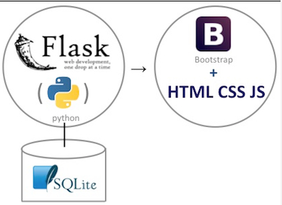



Web application Architecture
Technologies:
Flask | WSGI (Web Server Gateway Interface) web application framework
MongoDB |cross-platform document-oriented database program. Classified as a NoSQL database program, MongoDB uses JSON-like documents with schema
PhaserIO | desktop and mobile HTML5 game framework
MediBang

Slide 3

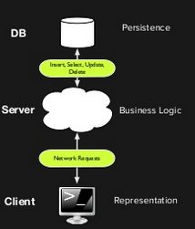
Flask WSGI (Web Server Gateway Interface)
What: web application framework
Language: Python
Server API: RESTful Web Services
Why: provides the user with libraries, modules and tools to help build Web-Applications using middlewares
Education:
writing custom backend will help you understand client server communication
Notes:
MVC opportunities for improvement
Middlewares: pluggable approach to add functionalities as needed; ass through components that form a pipeline between a server and application to inspect, route, or modify request and response messages for a specific purpose.
Form templates
Database interaction
File management

Slide 4

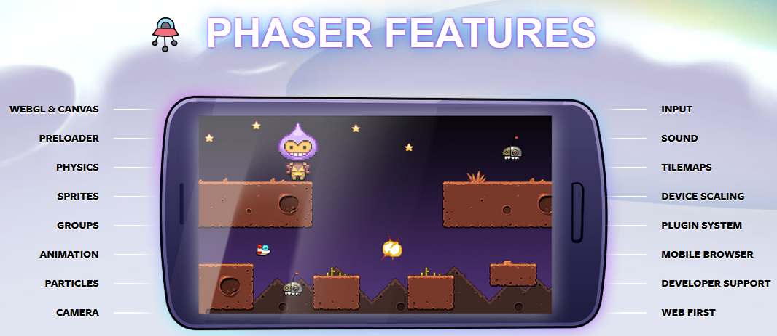
Phaser
What: Desktop and Mobile HTML5 game framework for 2D games
Language: JavaScript, Typescript
Why: uses both a Canvas and WebGL renderer internally and can automatically swap between them based on browser support. This allows for fast rendering across desktop and mobile
Education:
writing custom backend will help you understand client server communication

Slide 5
Evolution of Startegra Media
Start Small (2D Game)
- Recreate through tutorials
- Algorithms, Game Physics
Unity/Unreal (3D Game)
- Learn 3D Graphics and Associated Math (Linear Algebra)
- Implement ML/AI
- Game Monetization
- Publish
Notes:
diving in with a huge project is a guaranteed way to get overwhelmed, lost, frustrated, and fail. So again, pick the simplest game you can possibly think of to start.

Slide 6
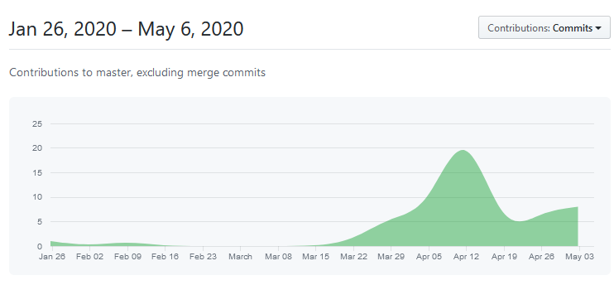
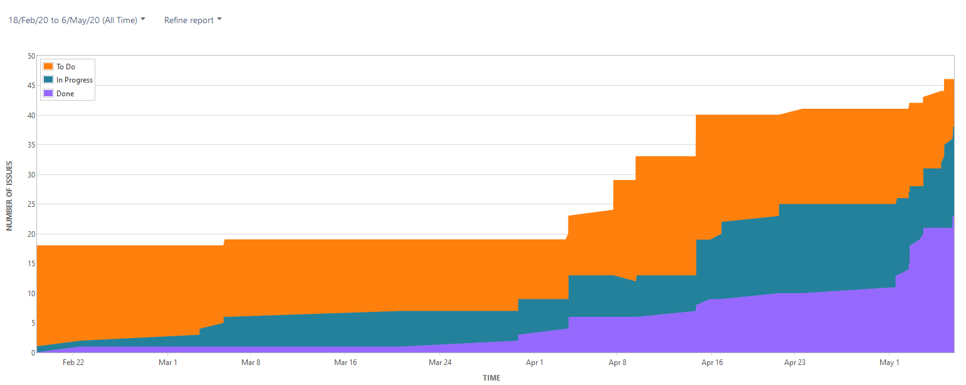
Agile Software Development
GITHUB | Commits
JIRA | Cumulative Flow Diagram
Link to GITHUB:
https://github.com/SE-4398/Slither
Link to JIRA: https://cs4398slither.atlassian.net/secure/RapidBoard.jspa?rapidView=1&projectKey=SLIT
Notes:
CFD: hows the statuses of issues over time. This helps you identify potential bottlenecks that need to be investigated.

Slide 7
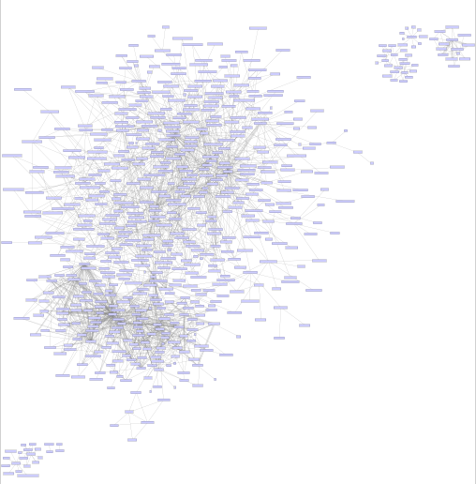
Java Module Dependencies
Webpack
Webpack/…/webpack.js
Mongodb
mongodb/…/collection.js
mongodb/…/utils.js
mongodb/…/index.js
Ts-loader
JQuery
Bootstrap
Notes:
webpack.config.js: used to direct webpack to enter through ./index.ts, load all .ts and .tsx files through the ts-loader, and output a bundle.js file in our current directory.

Slide 8
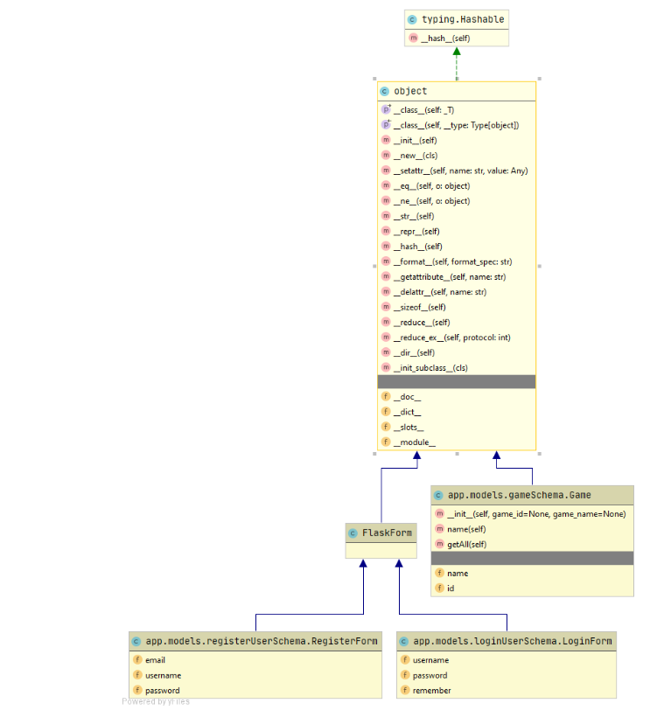
Python Class Diagram (Flask)
Inputs:
User Login (name, password) with reCaptcha
Session tokens
User Options (difficulty, snakeskin, background)
Outputs
Successful login
Ability for game play
Notes:
webpack.config.js: used to direct webpack to enter through ./index.ts, load all .ts and .tsx files through the ts-loader, and output a bundle.js file in our current directory.

Slide 9
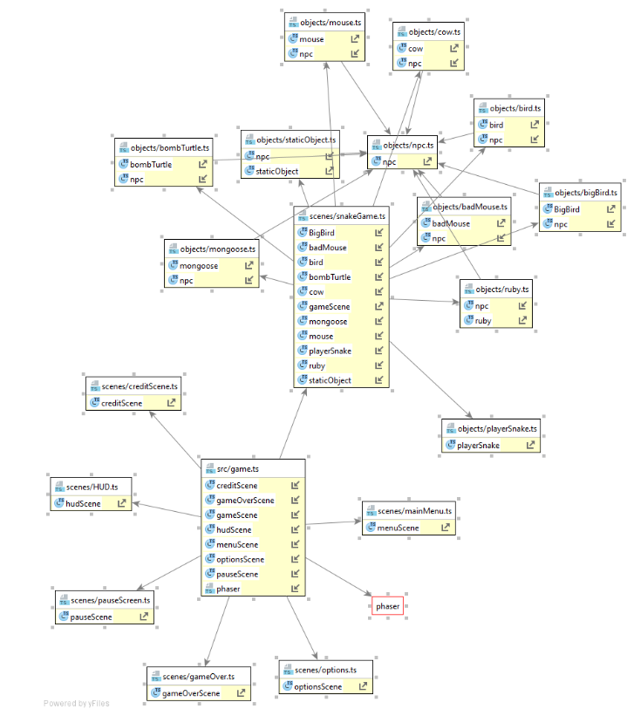
Typescript Class Diagram (Phaser)
Webpack
Webpack/…/webpack.js
Mongodb
mongodb/…/collection.js
mongodb/…/utils.js
mongodb/…/index.js
Ts-loader
JQuery
Bootstrap
Notes:
webpack.config.js: used to direct webpack to enter through ./index.ts, load all .ts and .tsx files through the ts-loader, and output a bundle.js file in our current directory.

Slide 10
FLASK STATE DIAGRAM
User navigates to website
User leaves website
Registration failed
Register Page
User quits game
Home Page - Not Logged in
User already registered
Login failed
Slither Game
Login Page
Homepage – Logged in
User Options Appended
Search Page Available Titles
User selects game [search selection]
User selects game [gallery selection]

Slide 11
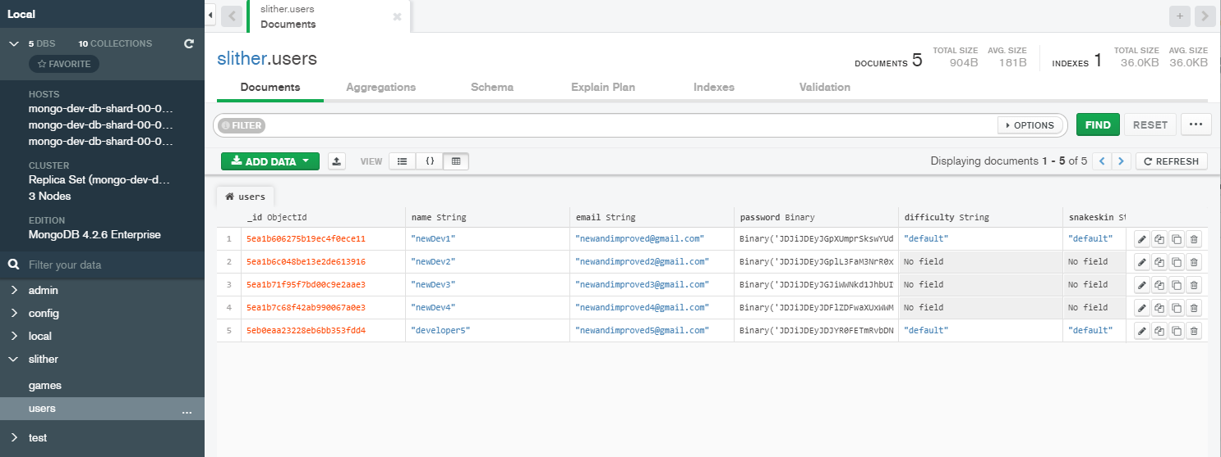
MongoDB Database Tables
Collections
Users
Games
Notes:
webpack.config.js: used to direct webpack to enter through ./index.ts, load all .ts and .tsx files through the ts-loader, and output a bundle.js file in our current directory.

